Slide 2


Release Train
Permission API
ING-RC
(snapshot for refresh)
Release
Permission API
Trunk/Master/Develop
auto-cut
Production
(vNext)
Feature
vNext package
vNext package
Release Candidate (DYN-RC)
End User
Delivery Master (DYN-DM)
vNext package
Production release have Canary capability for safe release. No customer impact Blue/Green deployment, release during business hours. Quick roll back for any major issue.
Team Region (BIAB-100+)
vNext package
Release Candidate(RC) environment ensures regression test quality. It is the final gate to production.
Delivery Master (DM) environment allow us find integration issues early.
Source code branches - Feature, trunk, master, develop, release
Environments – BIAB, DYN-DM, DYN-RC, Prod
Code package – vNext package
Process – auto-cut
BIAB give us the physical environment to ensure parallel development has no impact to other squads.
Comprehensive code line management methodology enables massive parallel development
Engineer
2

Slide 3
What is Bank in a Box(BIAB)
Australia’s DevTest environment to enable massive parallel development, Australia has more than 60 development squads
Each BIAB has it’s own frontend applications, middleware applications, Core Banking, Databases and Domain Controller – full Bank
BIAB is a Hybrid Cloud Implementation – On-premise Data Centre + Azure
Australia has more than 120 BIAB

Slide 4
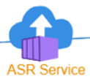
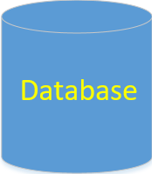
BIAB Environment
Hybrid Cloud
Frontend application, middleware applications, Core Banking and Databases – full Bank
Replication from On Premise Data Centre to Azure
On Premise Data Centre
About 60 VMs each BIAB
Total about 60 BIAB
Azure Public Cloud
About 60 VMs each BIAB
Total about 60 BIAB
4

Slide 5
Environment use case
Squad
Delivery Master(DM)
Release Candidate(RC)
Squad A Dev
Squad A Test
Delivery Master (DM)
Release Candidate (RC)
…
Squad X Dev
Multiple Squads Integration testing
Final regression testing before release
Squad X Test
Squad X signed off testing, ready for integration testing
5

Slide 6
Release Candidate Deployment and Gold Image
Gold Image is storage level of snapshot of Release Candidate(RC) environment that updated each week as part of release. This ensures Project environment we created based on latest Gold Image is up to date to Production.
Release Candidate(RC) Deployment include application releases, database changes as well as Operating System vulnerability patching.
6
6

Slide 7
BIAB creation process
Create from Gold image and thus always up to date to the latest production
Fully automated creation process – 30 minutes
Built-in environment smoke test

Slide 8
What is vNext and it’s Business value?
vNext is Australia’s Release Train scheduled to run weekly at a well defined time
Blue, Green deployment methodology, no customer impact release during business hours
Fast rollback in case of any major issue found post release
Canary capability for safe release
Comprehensive Observability Dashboard gives us full deep application status for informed decision making
Regression test for unknown application dependencies

Slide 9
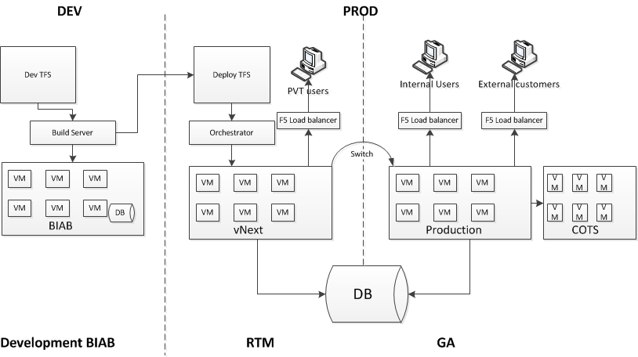
vNext process high level
New version of Bank(vNext) switched as Production version after PVT passed.
Going through multiple stages of BIAB test, including DM and RC, passed final regression test.
New version of the Bank(vNext) created in Production.
Application support team do final Production Verification Test(PVT).
Both Old and New version points to the same version of Database to ensure there’s no data lose.
Database backward compatible is the key design principle.

Slide 10
vNext switch – release to production
New Version
GA
Old Version
EXTWEB
DGW
BANCS
EXTWEB
EXTWEB
LIVE
MAPS
BATCH
BSL
STS
CARDS
LIVE
MAPS
BATCH
CARDS
BSL
STS
DGW
BANCS
LIVE
MAPS
BATCH
CARDS
BSL
STS
DGW
BANCS
BANCSBATCH
BANCSREPORTS
BANCSBATCH
BANCSREPORTS
BANCSBATCH
BANCSREPORTS
F5 Load balancer is used.
New version of 200+ applications will be add into GA pool.
The whole switch process takes about 30 minutes.
There’s no customer impact because we keep both Old and New version run concurrently for an hour before shutdown the old version.

Slide 11
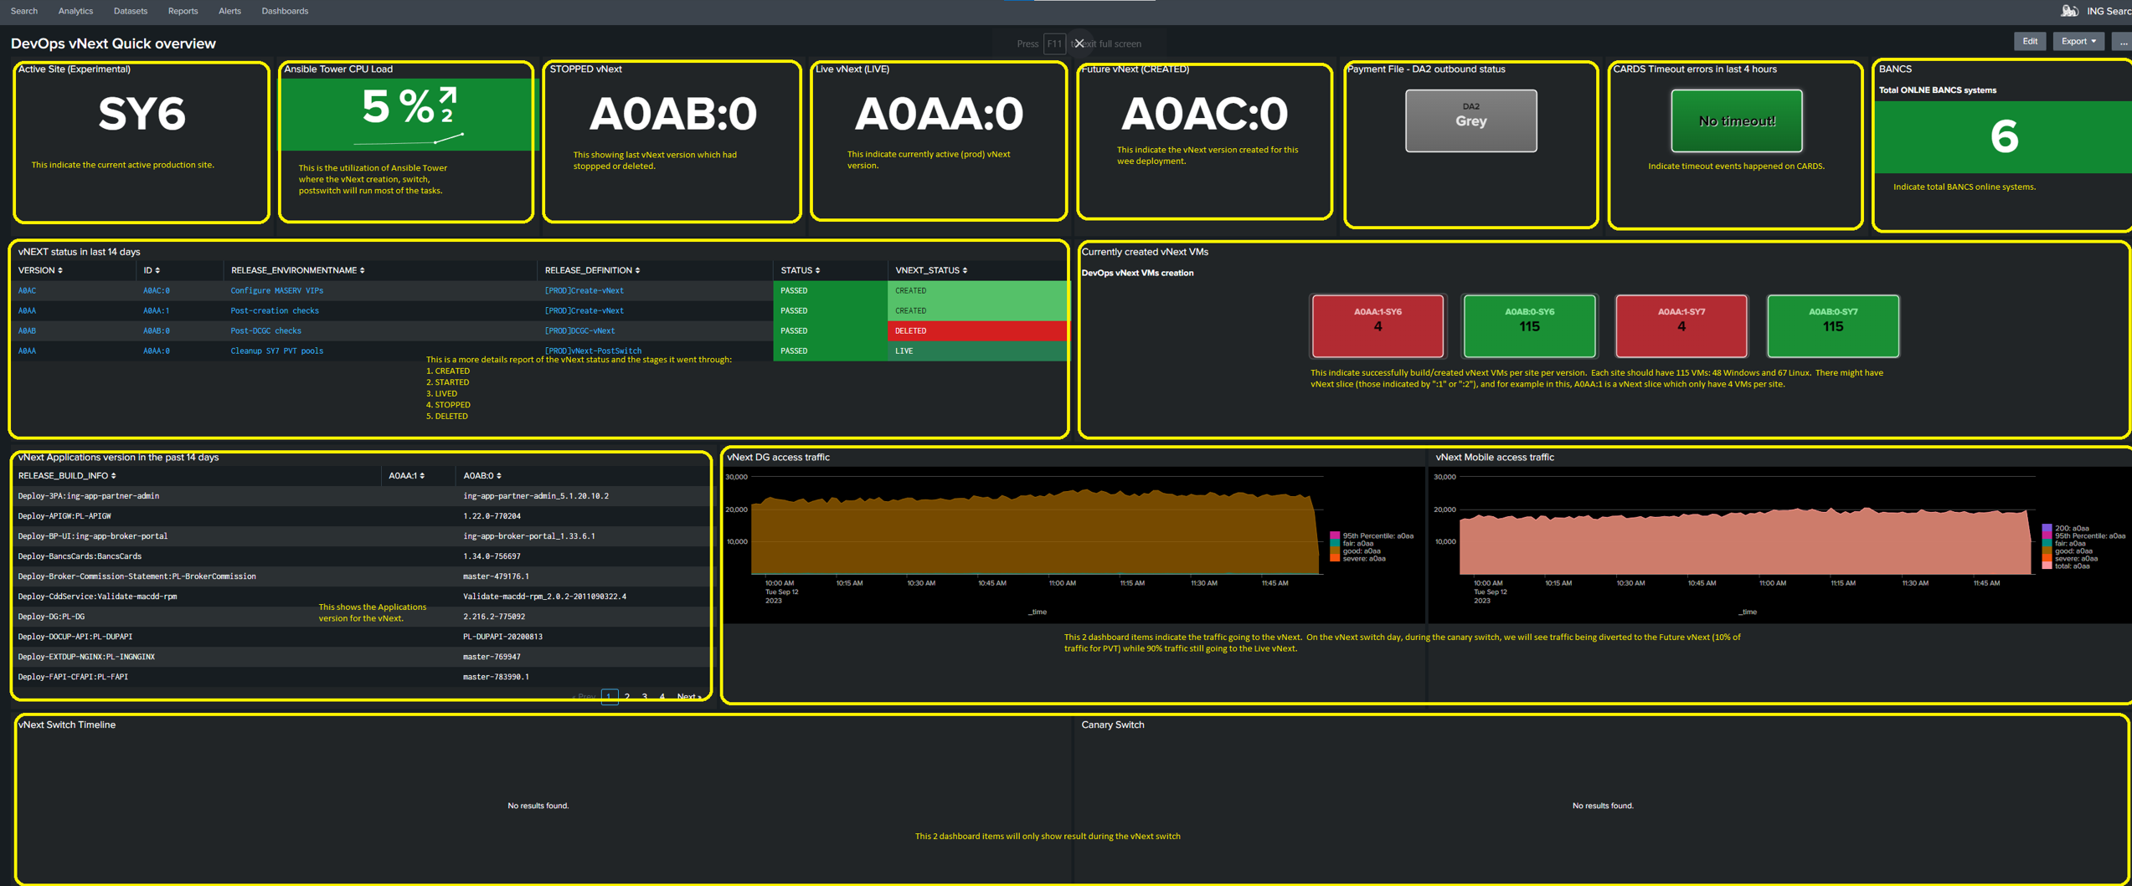
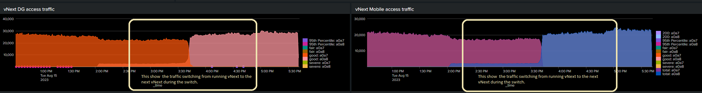
Observability dashboard for vNext infrastructure and application
Full visibility of vNext infrastructure, application status during Canary and Switch.

Slide 12
vNext rollback
Old Version
GA
New Version
EXTWEB
DGW
BANCS
EXTWEB
EXTWEB
LIVE
MAPS
BATCH
BSL
STS
CARDS
LIVE
MAPS
BATCH
CARDS
BSL
STS
DGW
BANCS
LIVE
MAPS
BATCH
CARDS
BSL
STS
DGW
BANCS
BANCSBATCH
BANCSREPORTS
BANCSBATCH
BANCSREPORTS
BANCSBATCH
BANCSREPORTS
Rollback is as simple as our release(switch) process. Just swap New and Old version.

Slide 13
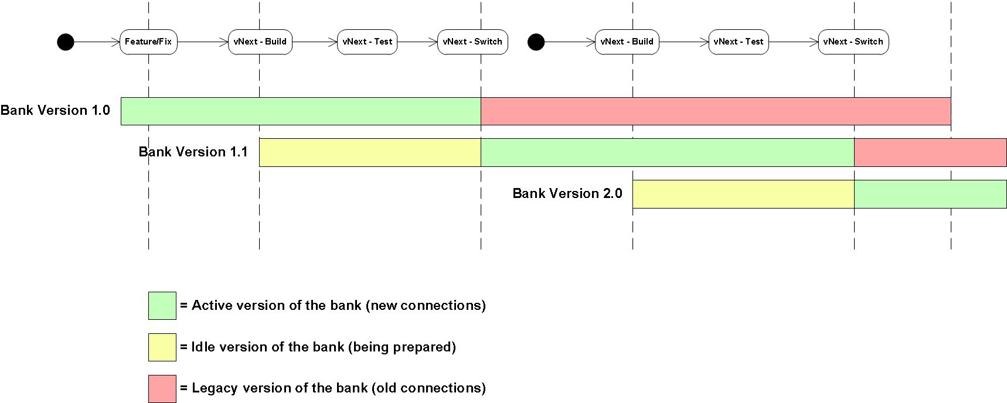
vNext release train schedule – weekly full bank release

Slide 14
vNext slice - express train 1
WEB
v
1
DG
v
1
vNext slice gives us capability for production emergency changes at application level.

Slide 15
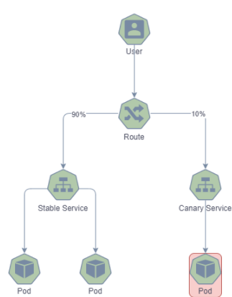
vNext express train 2 – Micro service application(MSA) release
2 sets of charts
Stable chart
Canary chart allow us release to x% customer before release to all customer – safe release
Application health is analyzed by the Engineer – self service
Approval process builtin for the Canary Rollback or Rollout to new version
Not time bounded
Controlled percentage traffic to canary version
All releases use Canary capability

Slide 16
TikTok – Data Centre Switching, Disaster Recovery (DR)
Process of moving all workloads from one datacenter to the other and diverting the customer traffic to the new data center
All external and internal links are diverted to the new data centre at the GTM level
Typically switch on a quarterly basis
TikTok is used for ING’s DR solution
TikTok solution is the backbone of Australia’s DR stage 6 maturity

Slide 17
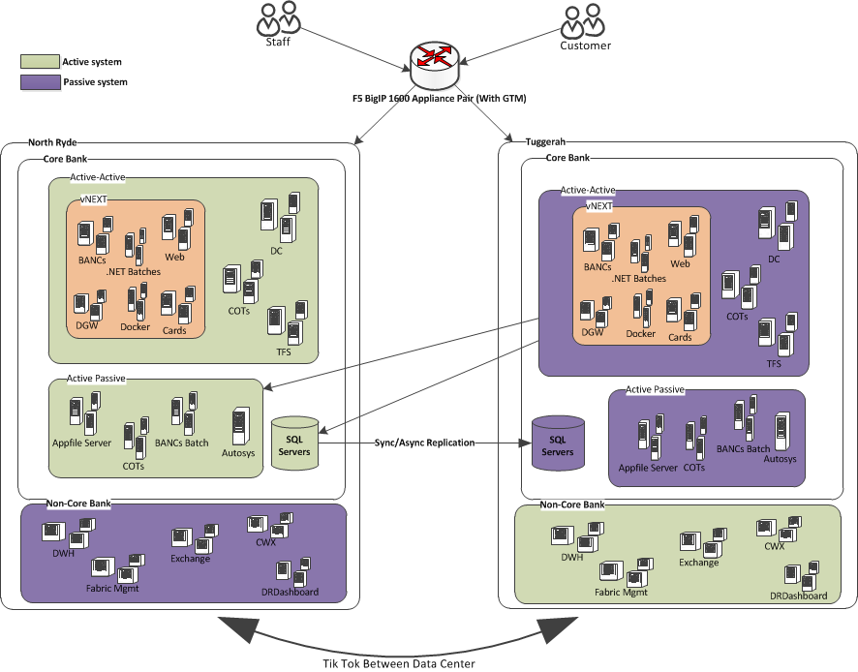
TikTok – Data Centre Switching, Disaster Recovery (DR)
SY6
SY7

Slide 18
Today’s landscape of test envs @ ING
Shared test env for platforms + consumers
Bank-in-a-box: separate test env for every project or logical deliverable
Test strategies differ from country to country; 2 extremes of this spectrum, both with pros and cons:
AUS tests using a “bank-in-a-box” (BIAB) model, with isolated and separate test envs for each application/project; there can be 200+ BIABs and counting.
NL* has a single centrally shared test env for *everyone* to test their stuff
* for the purpose of this deck, not listing all the variations in other ING EU countries

Slide 19
Pros and Cons of the shared env vs BIAB models
Dimension | Shared test env |  | Bank-in-a-box (BIAB)
 | Pros | Cons | Pros | Cons
Flexibility | Flexible: platform teams, consumers, all deploy as and when they want |  | Flexible: Each project or team is able to move at their own pace since they can test independent of the rest.
Stability |  | Unpredictable/chaotic: no guarantee of any microservice to be in stable state Data is shared, and hence you can affect each other’s test data and stability. | Test data is independent: You know that your own box is not affected by anyone else’s tests or state | BIAB only as stable as the platforms’ code and bundled base data within your box.
Maintainability & accountability |  | Poor. No one responsible or accountable for central shared env. If the shared env is broken, it is not clear who should fix it. Time consuming to debug |  | If the box containing 3 platforms is “broken” or unusable for a particular project, it is not clear where the problem lies and who should fix it
Scalability |  | More microservices => more chaos |  | Provider teams cannot maintain 100s of APIs across 100s of boxes – it is not realistic.

Slide 20

Both extremes today have limitations – how to proceed?
Shared test env for platforms + consumers
Bank-in-a-box: separate test env for every project or logical deliverable
Keep the current strategies at the back of our minds, and come up with some good practices that will help us be more robust and predictable.
* - for the purpose of this deck, not listing all the variations in other ING EU countries

Slide 21

Setting the scene for the evolution to next state

Slide 22
Seven principles of testing (ISTQB Foundation)
Testing shows the presence of defects, not their absence
Exhaustive testing is impossible
Early testing saves time and money
Defects cluster together
Beware of the pesticide paradox, periodically revisit and revise tests
Testing is context-dependent
Absence-of-errors is a fallacy

Slide 23

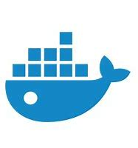
The continuous role of testing in the Software Development Lifecycle
Shift Left Testing
Continuous Planning
Continuous Integration
Continuous Testing
Continuous Deployment
Environment Provisioning
Staging
Deployment
Feature development and TDD cases
On-demand Test Container
Enterprise Application design/enhance
Build (execution of Unit tests)
Functional
NFR
Regression
Requirements
Integration Testing
Security Testing
Chaos Testing
API Contract Testing
GUI Testing
E2E Testing
Source code repository
Static analysis
System Testing
Persona Testing
Accessibility Testing
Smoke Testing
Test platform design/enhance
Compatibility Testing
Metrics
UAT
BDD Test Cases
Artifact repository
Integration Testing
Canary Deployments, A/B Testing
Security Testing
Test Data Management
Performance Testing
Performance Testing
Shift right testing
Test-related step
Other steps

Slide 24
Types of tests
The owning team writes and maintains tests* of one or more of these types as appropriate to the service:
Unit tests
Integration tests
Mock tests to mock out platform and external dependencies
Contract tests
Load tests
Smoke tests
Penetration & security tests
End to end tests including UI tests
User acceptance tests
Mobile device tests against connected backend envs
* See definition of each type of test in the glossary at the end of this deck.

Slide 25
Where to run tests?
CI/CD Pipeline
All automated tests: unit, smoke, integration, contract tests, etc. must run in the CI/CD pipeline whenever deploying to any env. Only if the test suite succeeds will the build artefact be created and deployed
Test envs
Manual test are done as appropriate in dev, test, and acc envs
Load tests
UI Tests (Selenium, etc.) run via the pipeline may connect to services in the test env
Acceptance envs
User acceptance tests
Mobile device tests
Production
Sanity checks
CMS content manual tests
A B tests ☺

